Slide 1
Students Live behaviour monitoring in online classes using Artificial intelligence
Guide:
Presented by:

Slide 2
Abstract
Due to the health emergency situation, which forced universities to stop using their centers as a means of teaching, many of them opted for virtual education.
Affecting the learning process of students, which has predisposed many of them to become familiar with this new learning process, making the use of virtual platforms more common.
Many educational centers have come to rely on digital tools such as: Discord, Google Meet, Microsoft Team, Skype and Zoom. The objective of the research is to report on the impact of student learning through the use of the aforementioned videoconferencing tools.
Surveys were conducted with teachers and students who stated that 66% were not affected in their educational development

Slide 3
Introduction
Many factors affect a student’s academic performance. Student achievement depends on teachers, education programs, learning environment, study hours, academic infrastructure, institutional climate, and financial issues . Another extremely important factor is the learner’s behavior.
The major constructs of study behavior, including study skills, study attitude, and motivation, to have strong interaction with students’ learning results.
Students’ perceptions of the teaching and learning environments influence their study behavior..

Slide 4
continues
This means if teachers can grasp the bad attitudes of students, they can make more reasonable adjustments to change the learning environment for the students.
To conclude whether good or bad behavior for a particular student is not an easy problem to solve, it must be identified by the teacher who has worked directly in the real environment

Slide 5
Problem Definition
Human behavior analysis is an important area of computer vision research dedicated to the detection, monitoring and understanding human physical actions .
The teaching and learning cycle may be regarded to be the most critical operation in the academic institution.
During classes, attendance and student behavior are closely monitored alongside teaching activities .
Information has demonstrated that student interest is a central element in participation and performance .
Teachers will be able to track student activity and recognize relevant indicators to draw assumptions regarding the student's real involvement in learning experiences .
However, people’s behavior is unpredictable to most situations and monitoring is quite challenging specially for a big scenario

Slide 6
Objective
The objective of this research was to build an automatic system that allowed the faculties to capture and make a summary of student behaviors in the classroom as a part of data acquisition for the decision making process.
The system records the entire session and identifies when the students pay attention in the classroom, and then reports to the facilities.

Slide 7
EXISTING SYSTEM
Currently, in times of pandemic, teaching is at a distance where the use of different means of videoconferencing is relevant in education. Since, it has a very significant role in the learning experience of the students.
The theoretical classes of the data shows that identified students were less focused on the board/slide than their classmates. This is most likely an indication of a lack of concentration during class. The teacher could take action to bring each student’s concentration back.

Slide 8
Disadvantages
If no student is identified in a class, and the academic portal still shows that the class was actually taken, there is a high possibility of a lack of communication between the lecturer and the class room).
Even when the decisions made based on student observation data are hard and not sufficiently convincing, it can be used for notifying them about outliers.
Studies related to student behavior analysis in the classroom can benefit from these results.
Previous works have not taken advantage of deep learning for statistical analysis or have
only applied old computer vision models.

Slide 9
PROPOSED SYSTEM
In proposed system artificial intelligent is used to predict behaviour of student in online classes when student is live.
Student features are captured from every frame and data is analyzed based on different types of activity related to eye movement, mouth movements, head movements and analysis is done on student active status on that respective class.
Graphical representation is used to show performance of student.

Slide 10
Advantages
Helps in understanding interest of student for respective class.
Teachers can take decisions in improving effective ways of teachings.

Slide 11
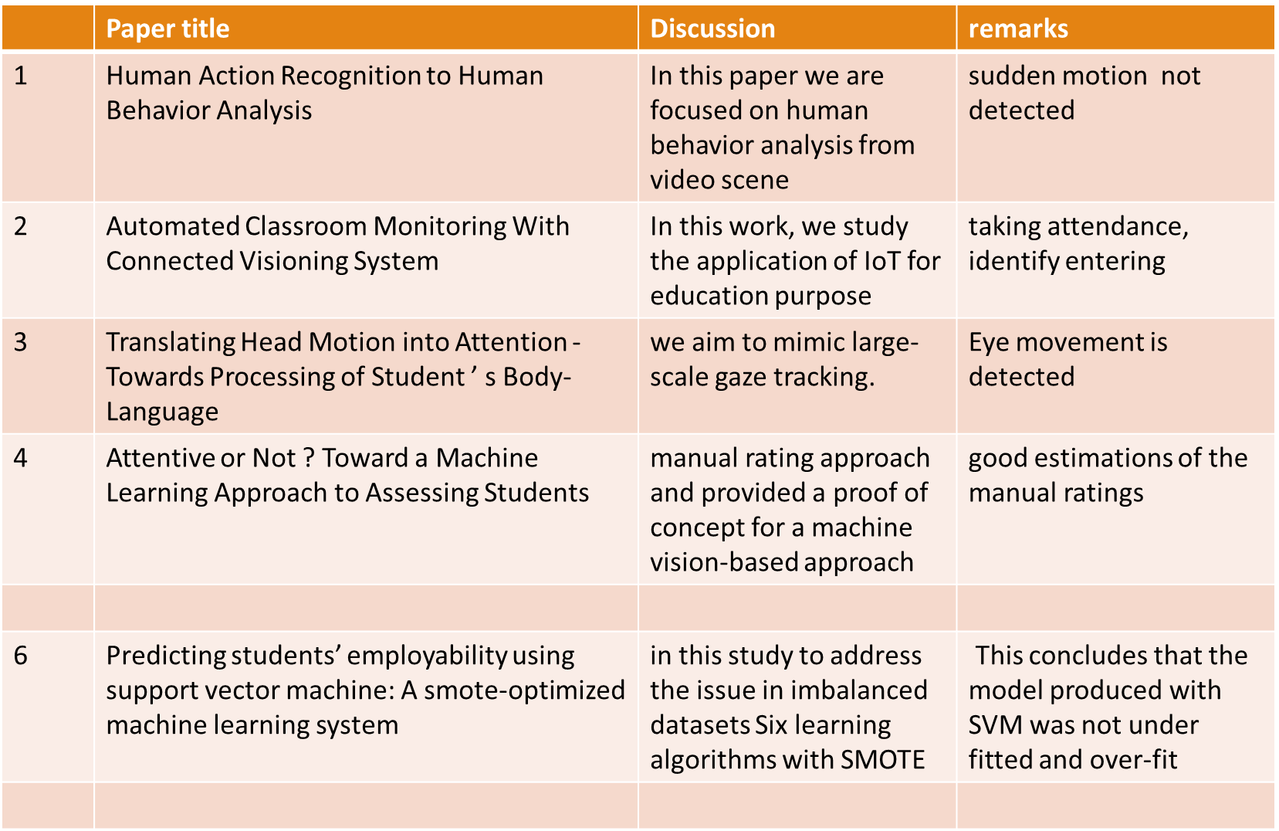
LITERATURE SURVEY

Slide 12
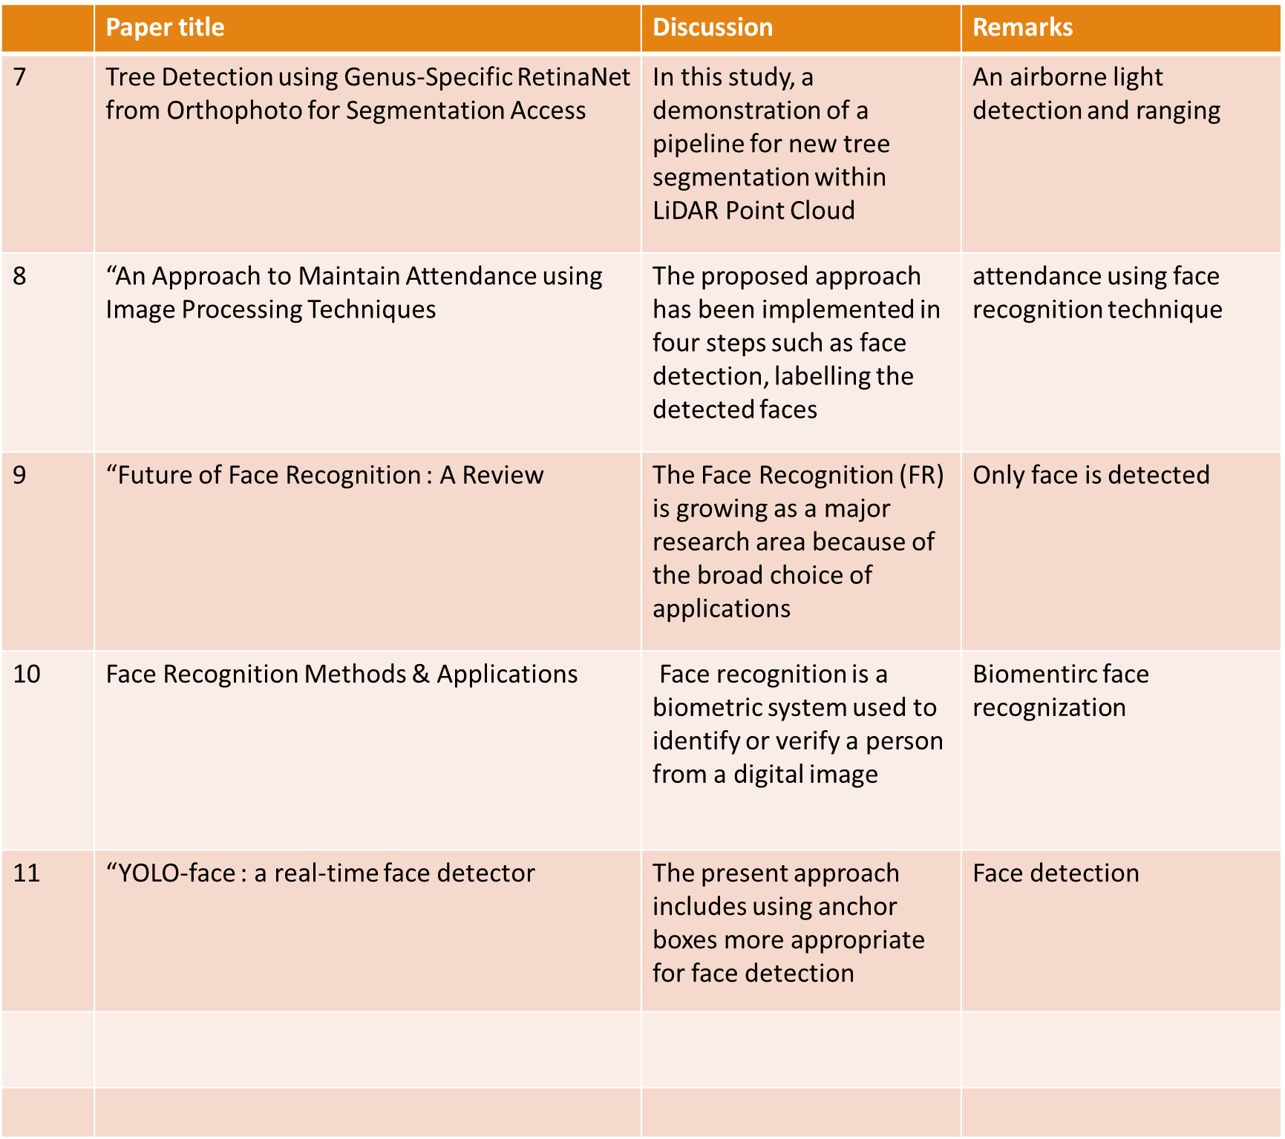
Continues

Slide 13
Hardware requirements
System : Pentium IV 2.4 GHz.
Hard Disk : 100 GB.
Monitor : 15 VGA Color.
Mouse : Logitech.
RAM : 1 GB.

Slide 14
Software requirements
Operating system : Windows XP/7/10
Coding Language : Python
Development Kit : Jupiter notebook
Programming language : Python

Slide 15
Limitation
Our first limitation includes the lack of monitoring of other useful information, such as emotions. More behavior-detection methods, such as facial expression, body pose, etc
Another issue that we want to investigate more clearly, is the level of correlation between behaviors and the outcomes of students. This system could be utilized as the basis for further studies about those correlations in different environments. Our graphs displayed on the web application were said to be difficult to use for non-technical users.

Slide 16
Conclusion
This research aimed to build a system that automatically supports teachers and related educational faculties with monitoring student behavior. We focused on the observation targets of the students across time. The system works as an assistant for the decision-making process. The strategic information may be discovered and delivered to the decision-makers automatically. We accomplished the building of an entire system that supports recording student behaviors, proceeding statistics, and visualizing the data. We provided the details of development and experiments and show the feasibility of combining model techniques to solve the student-behavior-tracking puzzle.

Slide 17
REFERENCES
[1] S. Wang, L. L. Minku, and X. Yao, “Resampling-based ensemble methods for online class imbalance learning,” IEEE Transactions on Knowledge and Data Engineering, vol. 27, no. 5, pp. 1356–1368, 2015.
[2] J. Nainggolan, G. Christian, K. Adari, Y. Bandung, K. Mutijarsa, and L. B. Subekti, “Design and implementation of virtual class box 5.0 for distance learning in rural areas,” in 2016 8th International Conference on Information Technology and Electrical Engineering (ICITEE), 2016, pp. 1–6.
[3] F. Lu, X. Chen, X. Ma, Z. Liu, and Y. Chen, “The exploration and practice of it solutions for online classes in higher education during covid-19 pandemic,” in 2020 International Symposium on Educational Technology (ISET), 2020, pp. 298–302.
[4] C. Marconi, C. Brovetto, I. Mendez, and M. Perera, “Learning through videoconference. research on teaching quality,” in 2018 XIII Latin American Conference on Learning Technologies (LACLO), 2018, pp. 37–40.
[5] M. Vladoiu and Z. Constantinescu, “Learning during covid-19 pandemic: Online education community, based on discord,” in 2020 19th RoEduNet Conference: Networking in Education and Research (RoEduNet), 2020, pp. 1–6

